Slide 1

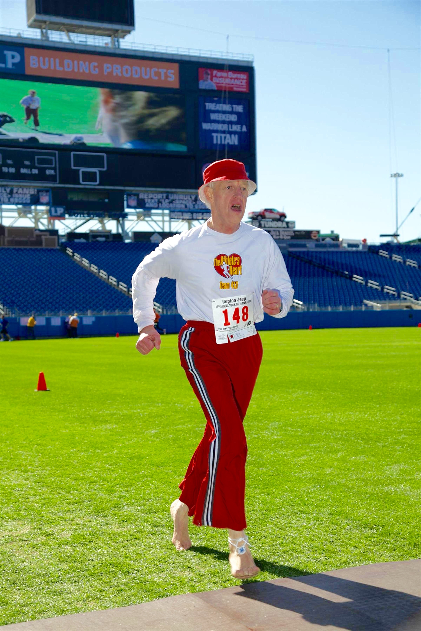
What I’ve Learned about Life from Barefoot Running

Slide 2
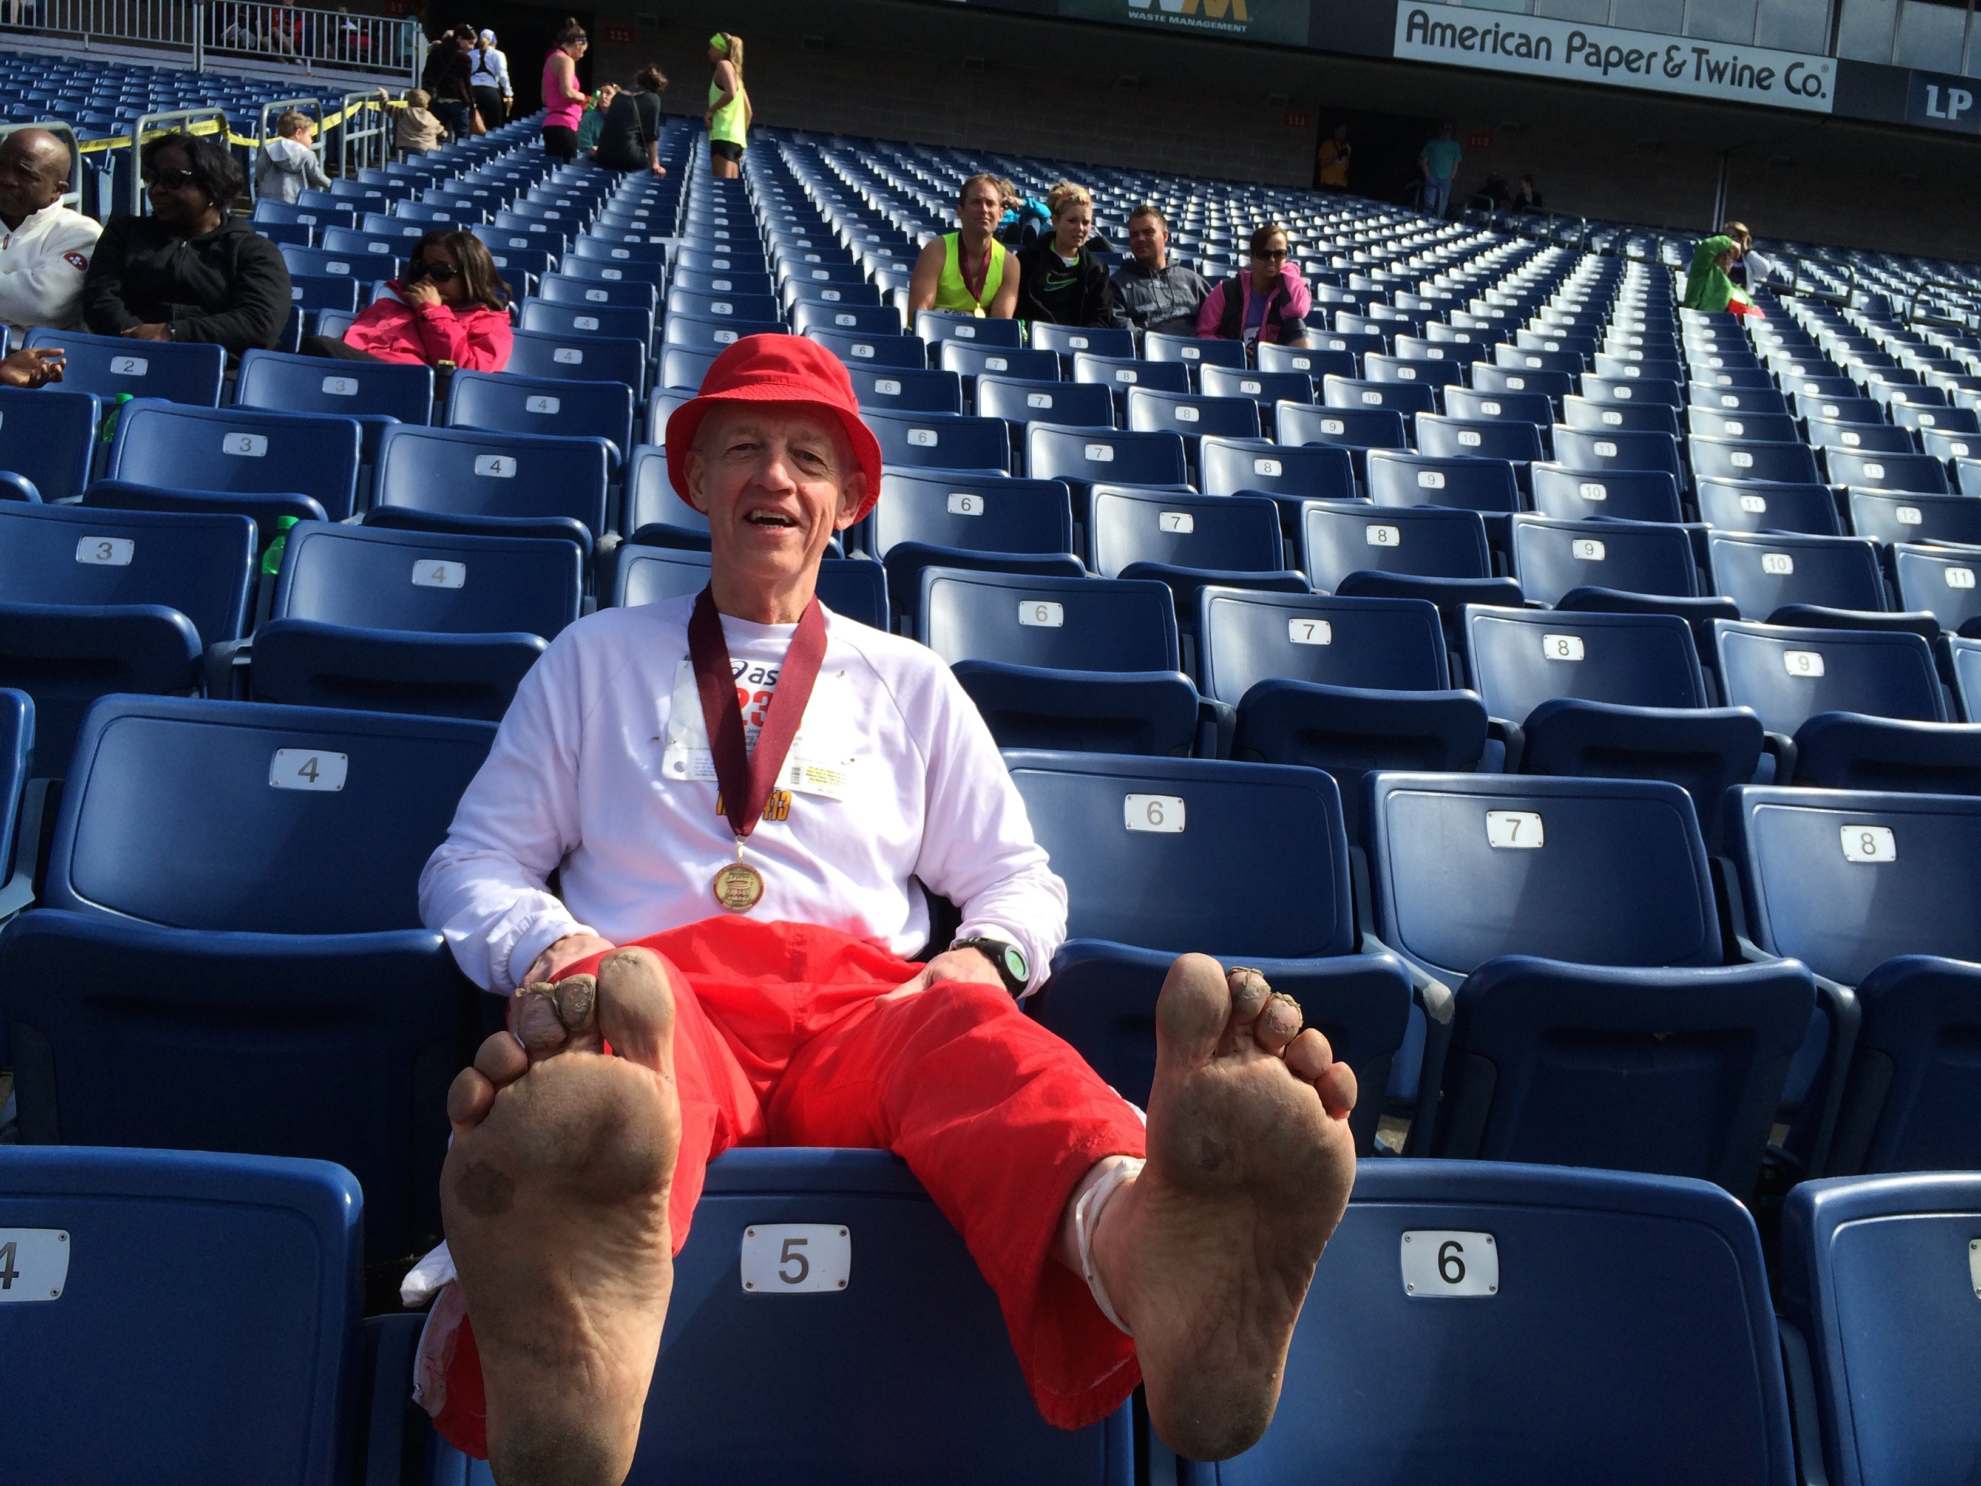
Life is painful

Slide 3

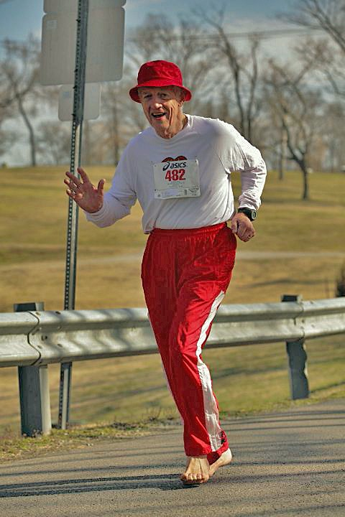
Some big things can be done by doing little things consistently

Slide 4
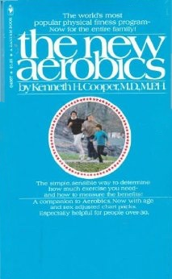
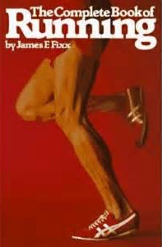
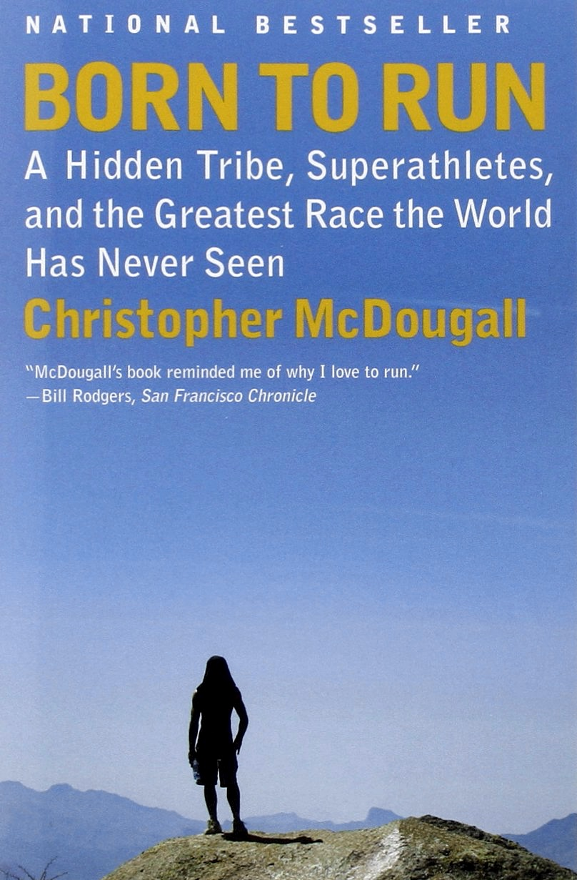
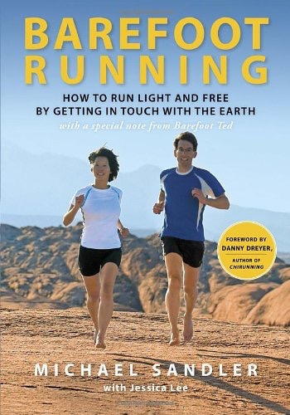
Good books encourage better running

Slide 5
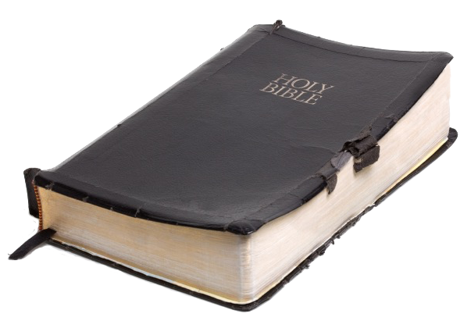
The
GOOD BOOK
encourages
holy living

Slide 6

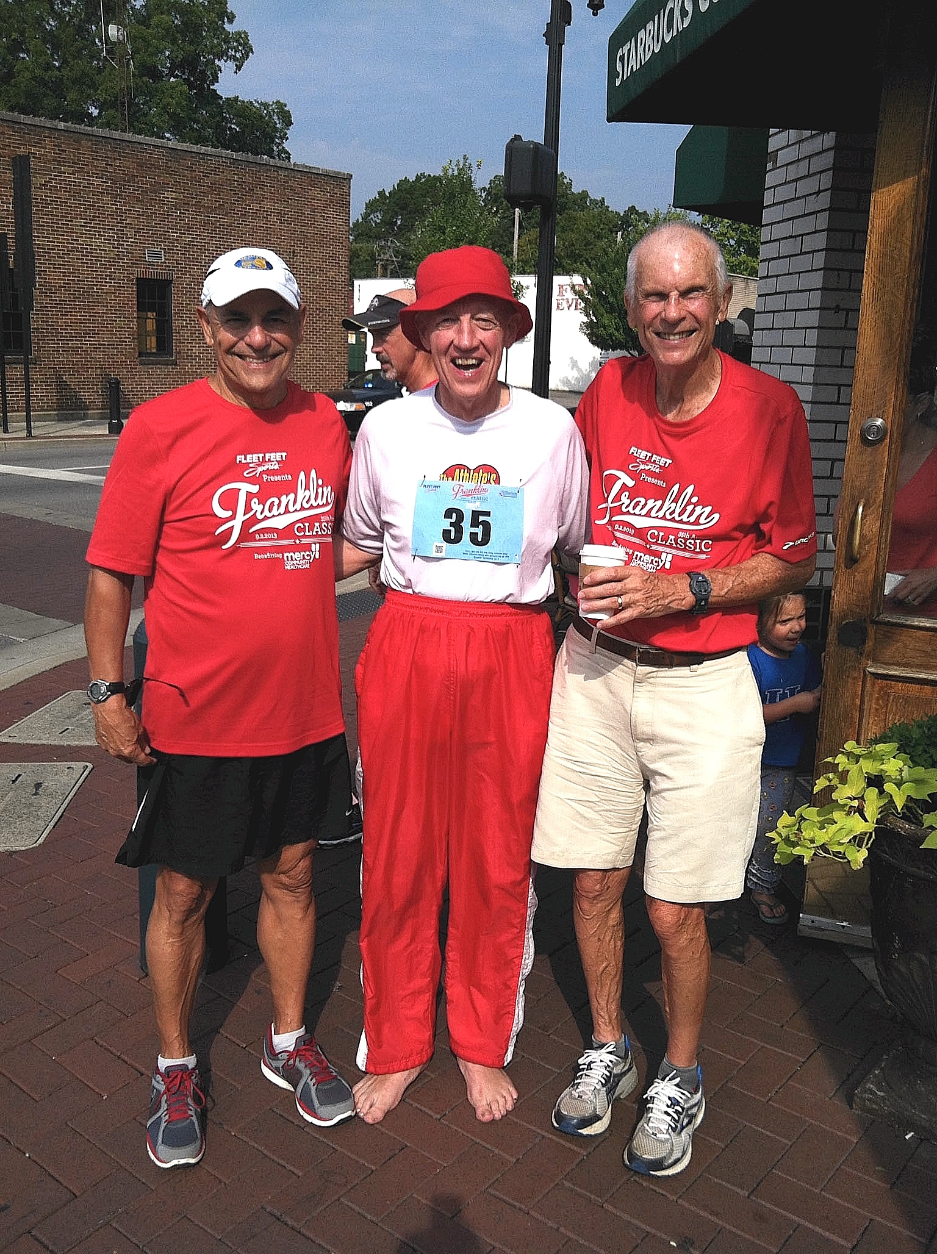
Important things take a commitment — not a trial

Slide 7

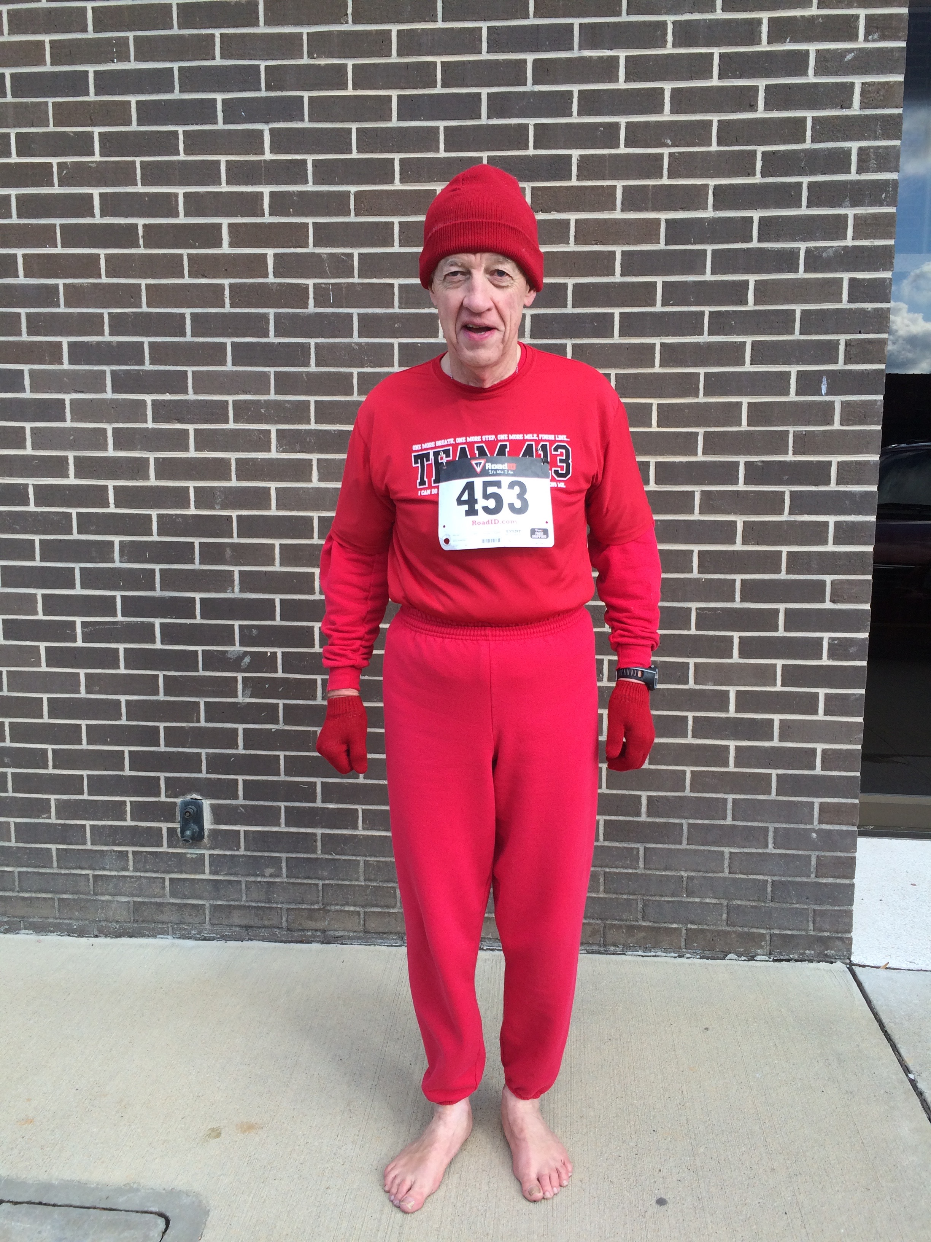
Many people will think you are weird

Slide 8

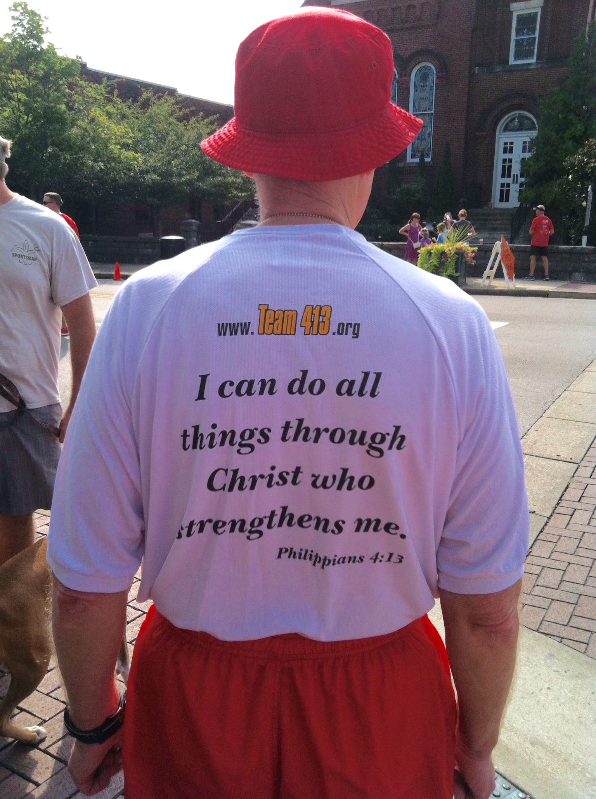
It’s
worth
it!

Slide 9
What I’ve Learned about Life from Barefoot Running

